Slide 1


R, NONMEM®, WinNonlin®의 약동학 모형 적합 결과 비교
배 균 섭
서울아산병원
울산대학교

Slide 2



Slide 3
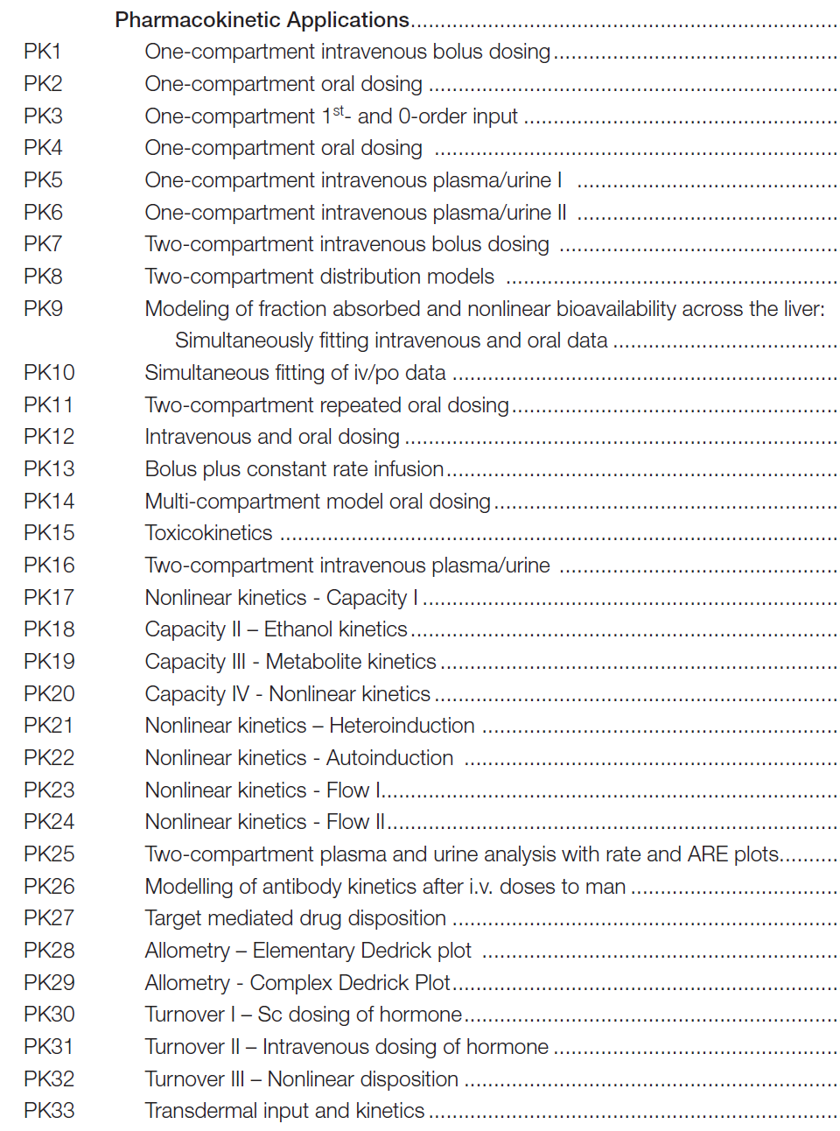
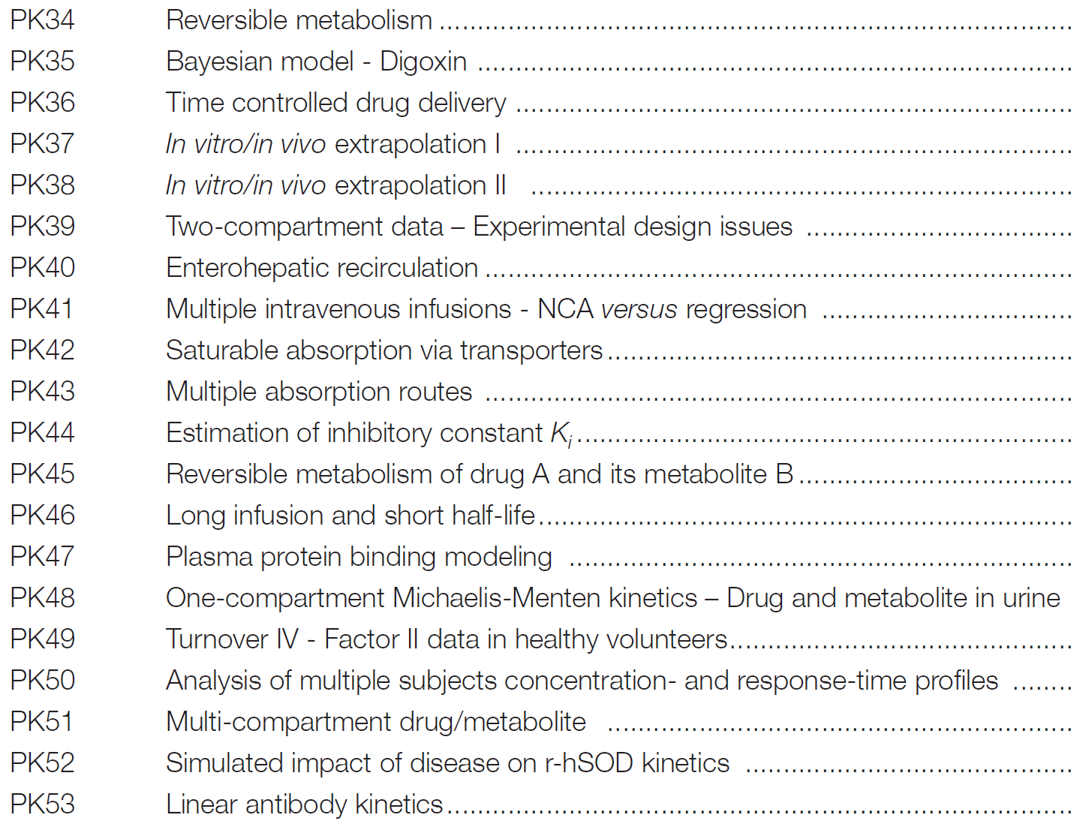

Slide 4
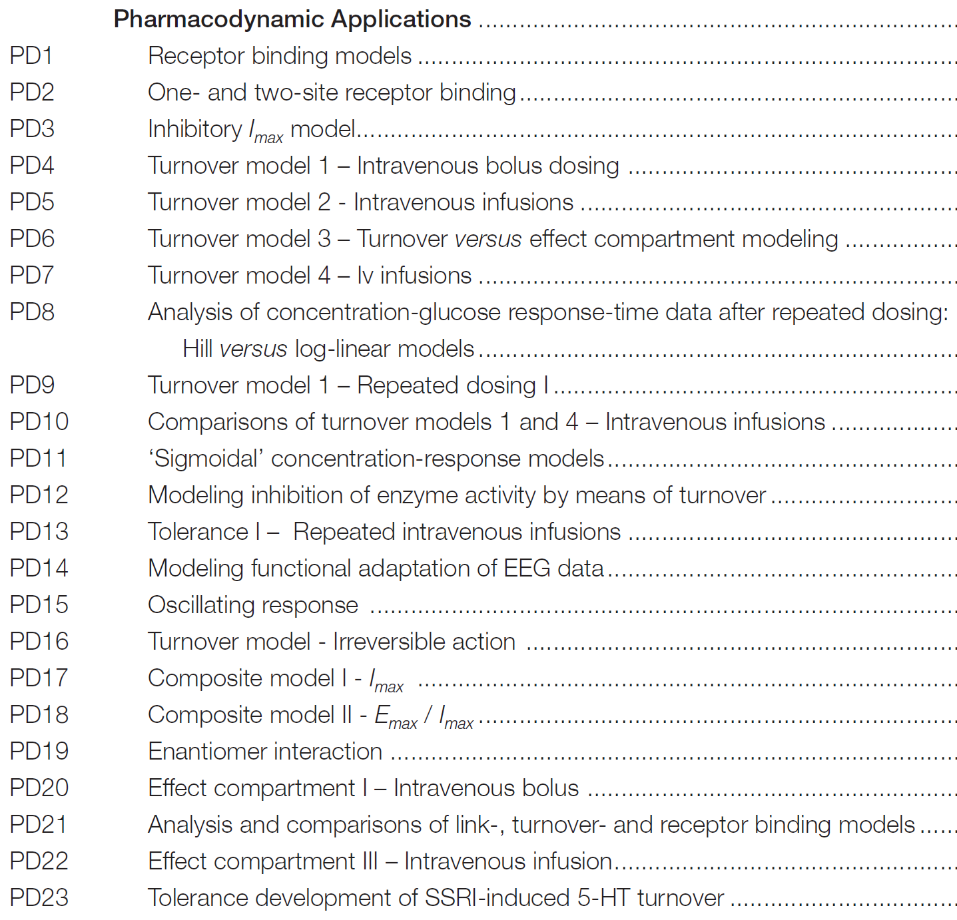
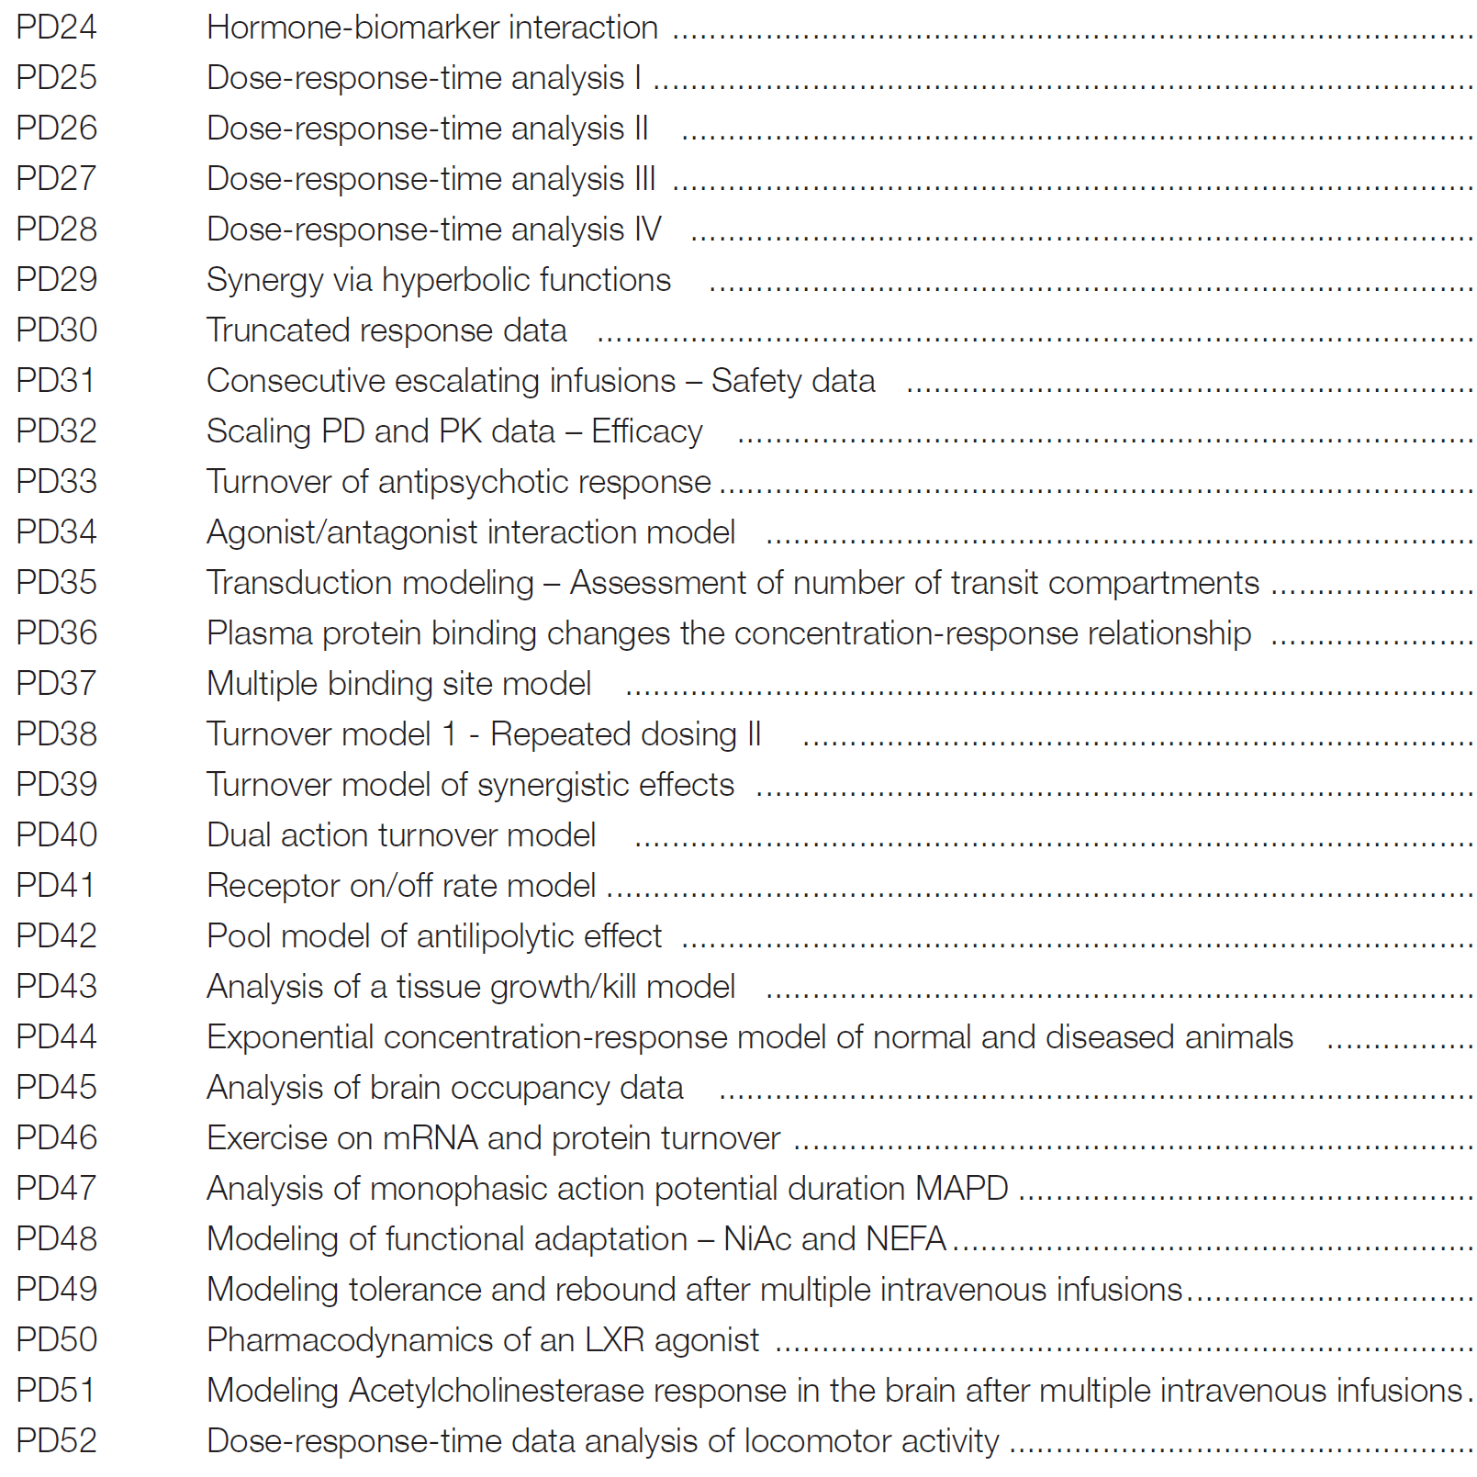

Slide 5
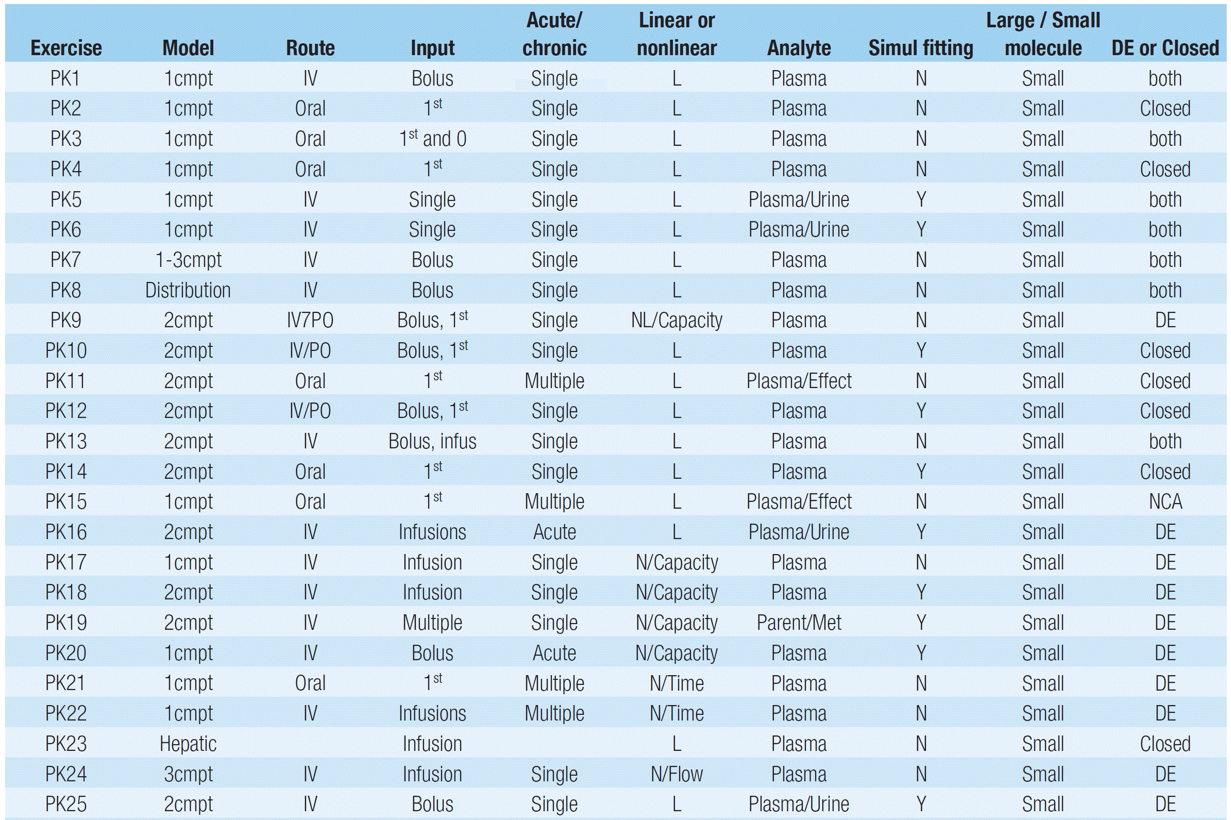

Slide 6
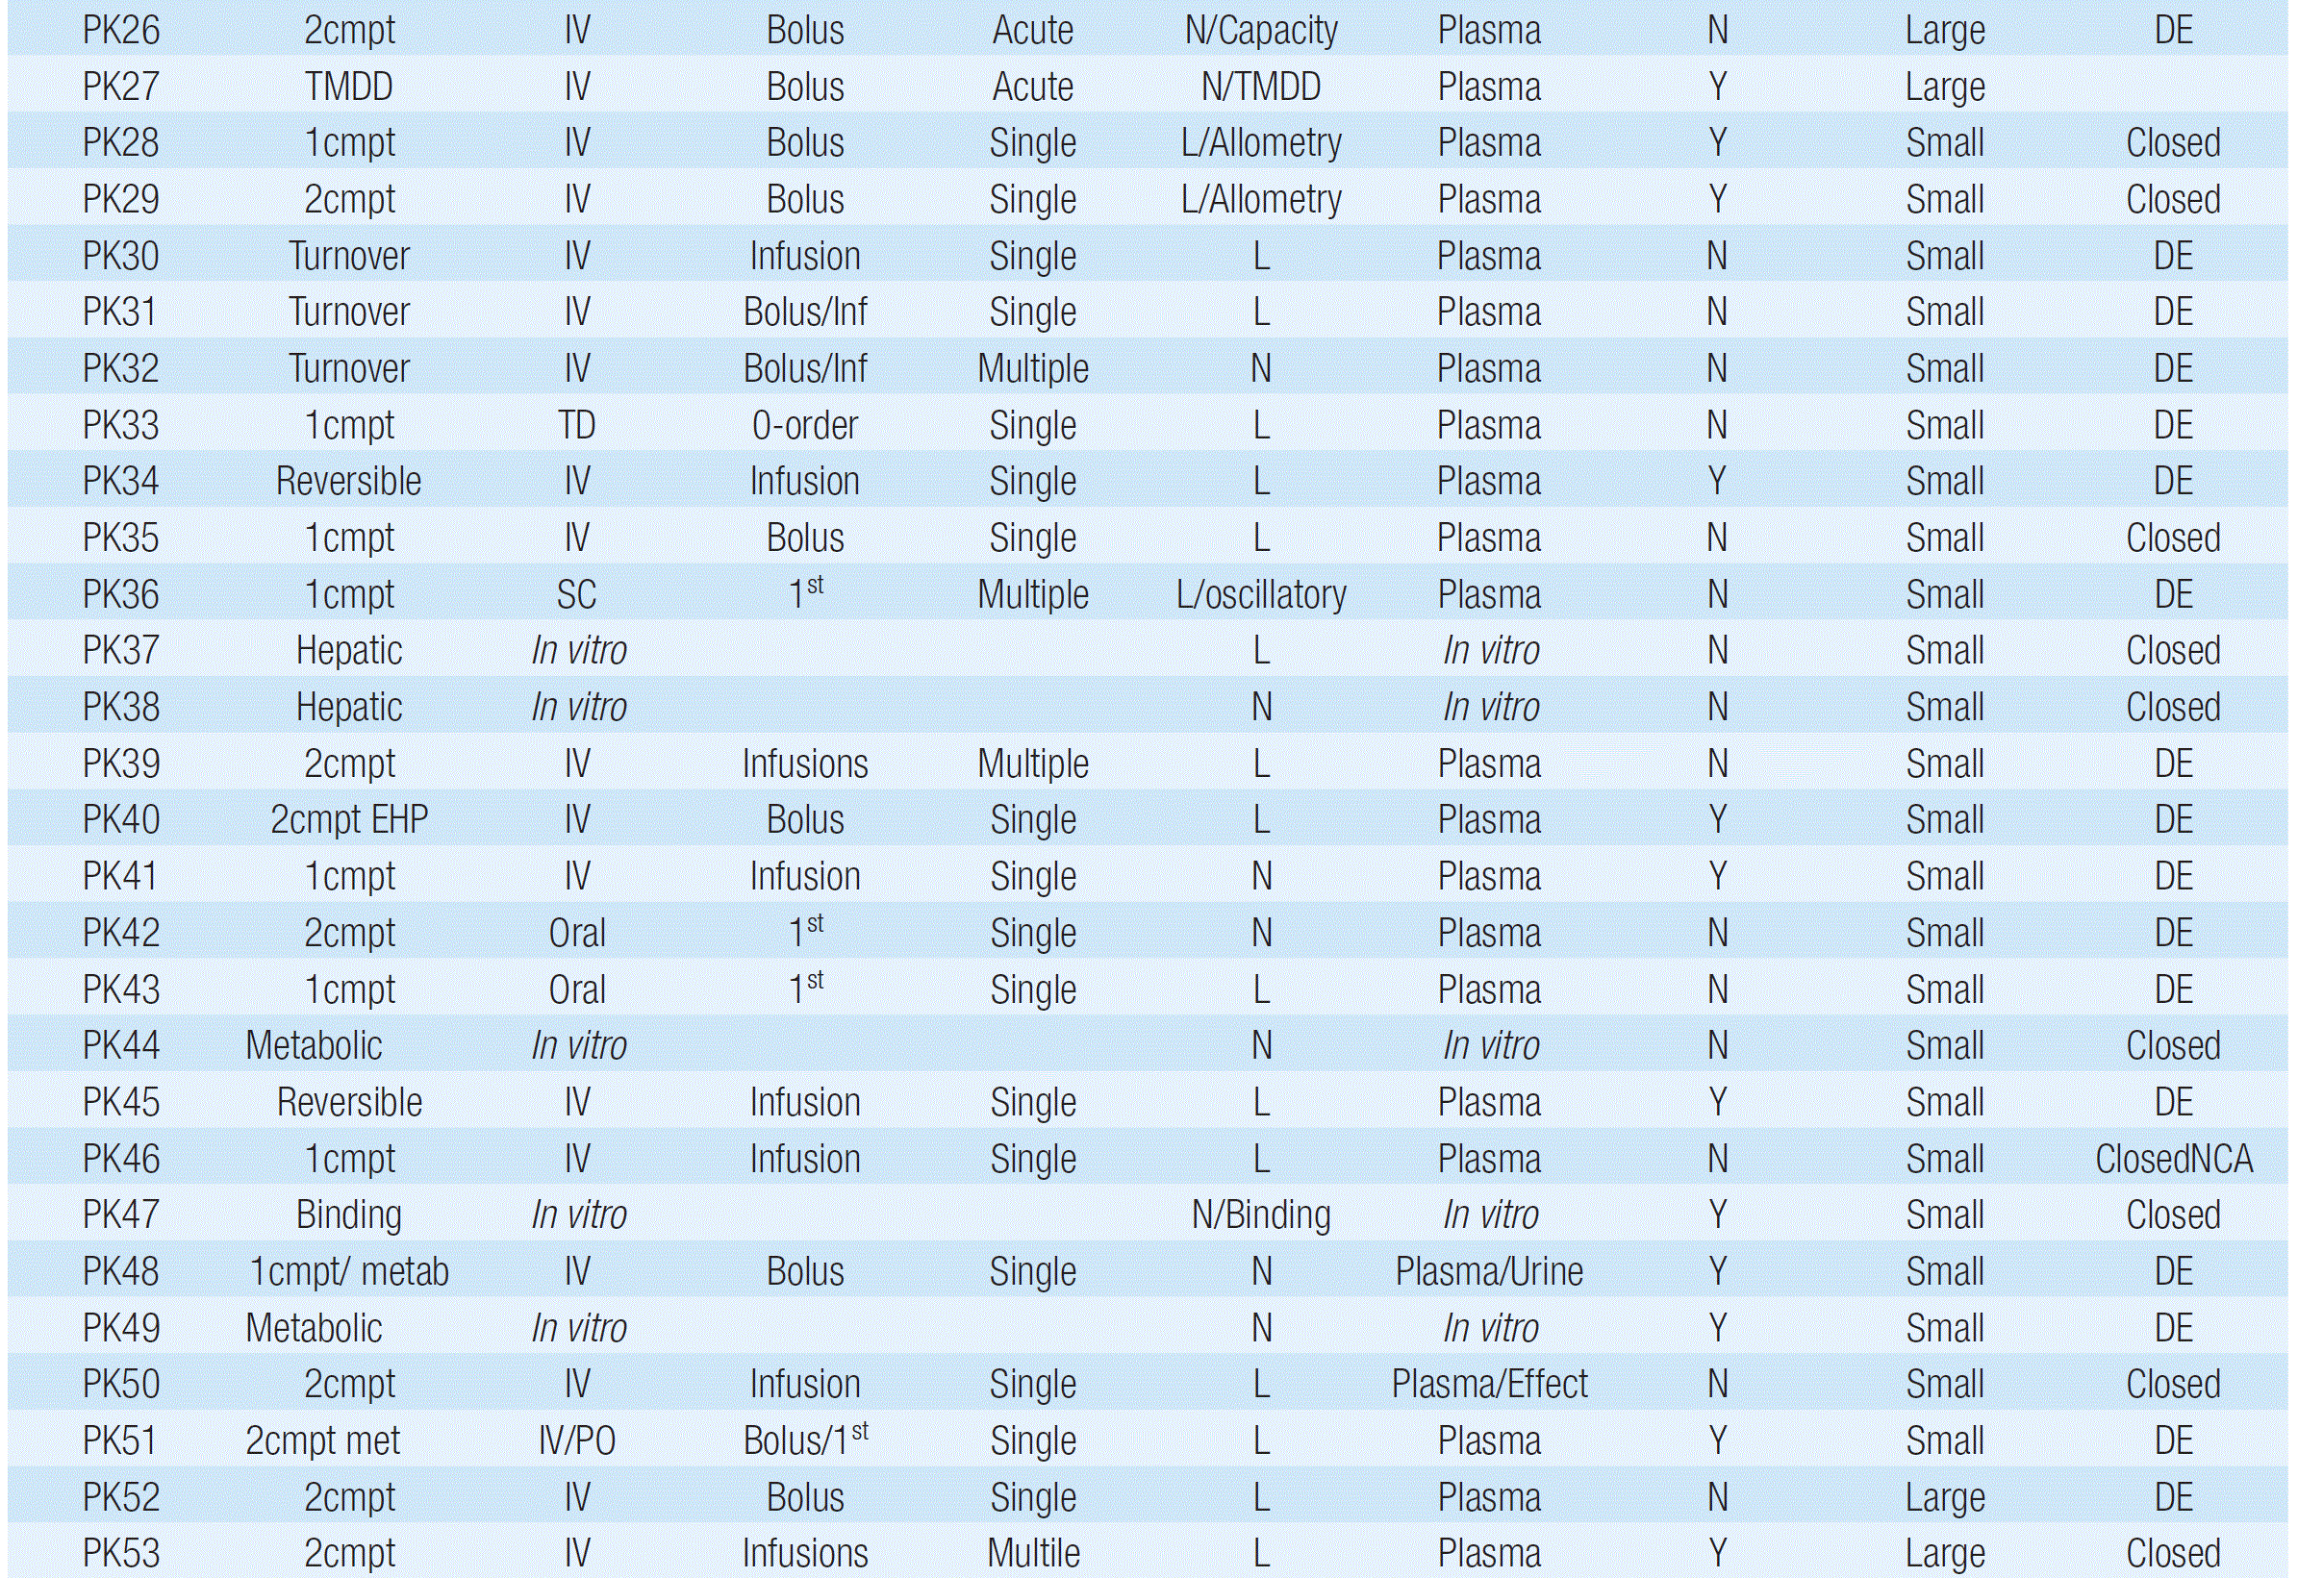

Slide 7
PK2 – One compartment oral dosing
TIME DV
1 10 0.00
2 15 0.28
3 20 0.55
4 30 1.20
5 40 2.00
6 60 1.95
7 90 1.85
8 120 1.60
9 180 0.86
10 210 0.78
11 240 0.60
12 300 0.21
13 360 0.18
Parameter | tvKa | tvV | tvKe | tvTlag
Estimate | 0.042925 | 32.0625 | 0.00879 | 15.6085
Stderr | 0.009492 | 3.120785 | 0.00114 | 1.509205
CV% | 22.11275 | 9.733443 | 12.97025 | 9.669123
$Est
ka V k tlag
PE 0.027469911 27.353876 0.010511280 11.375450
SE 0.006059932 4.148751 0.001937513 0.867595
RSE 22.060253988 15.166957 18.432707310 7.626907

Slide 8
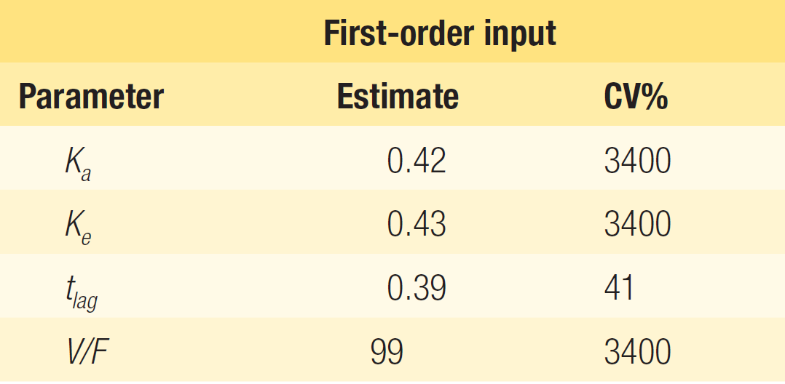
PK3 One-compartment 1st- and 0-order input
Parameter | KA | KE | TLAG | FV
Estimate | 0.432125 | 0.428274 | 0.44011 | 99.06326
Stderr | 37.76967 | 37.32454 | 0.434079 | 8622.433
CV% | 8740.447 | 8715.1 | 98.62976 | 8703.967
WNL5
$Est
Ka Ke tlag V/F
PE 0.4245171 0.4244273 0.3947633 99.35091
SE 0.1403394 0.1403091 0.1130432 32.63545
RSE 33.0585981 33.0584658 28.6356898 32.84867

Slide 9
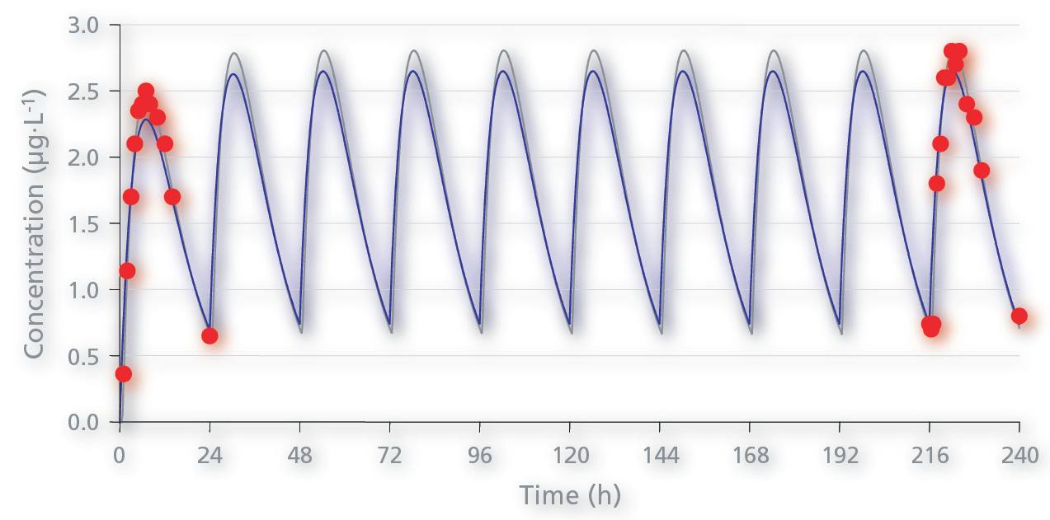
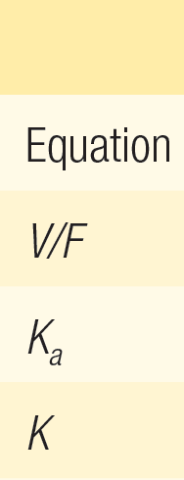
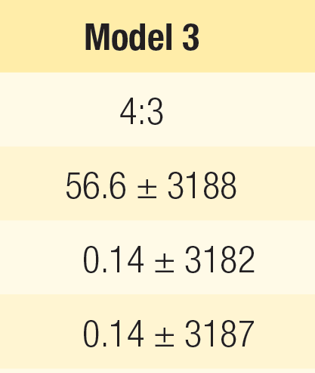
PK4 One-compartment oral dosing
Parameter | V_F | K01 | K10
Estimate | 56.66937 | 0.142538 | 0.142966
Stderr | 3077.525 | 7.732394 | 7.763661
CV% | 5430.668 | 5424.807 | 5430.408
WNL5
Parameter | tvV | tvKa | tvKe
Estimate | 56.7418 | 0.143138 | 0.143138
Stderr | 9.446534 | 0.023986 | 0.023986
CV% | 16.64828 | 16.75699 | 16.75699
WNL6.4

Slide 10
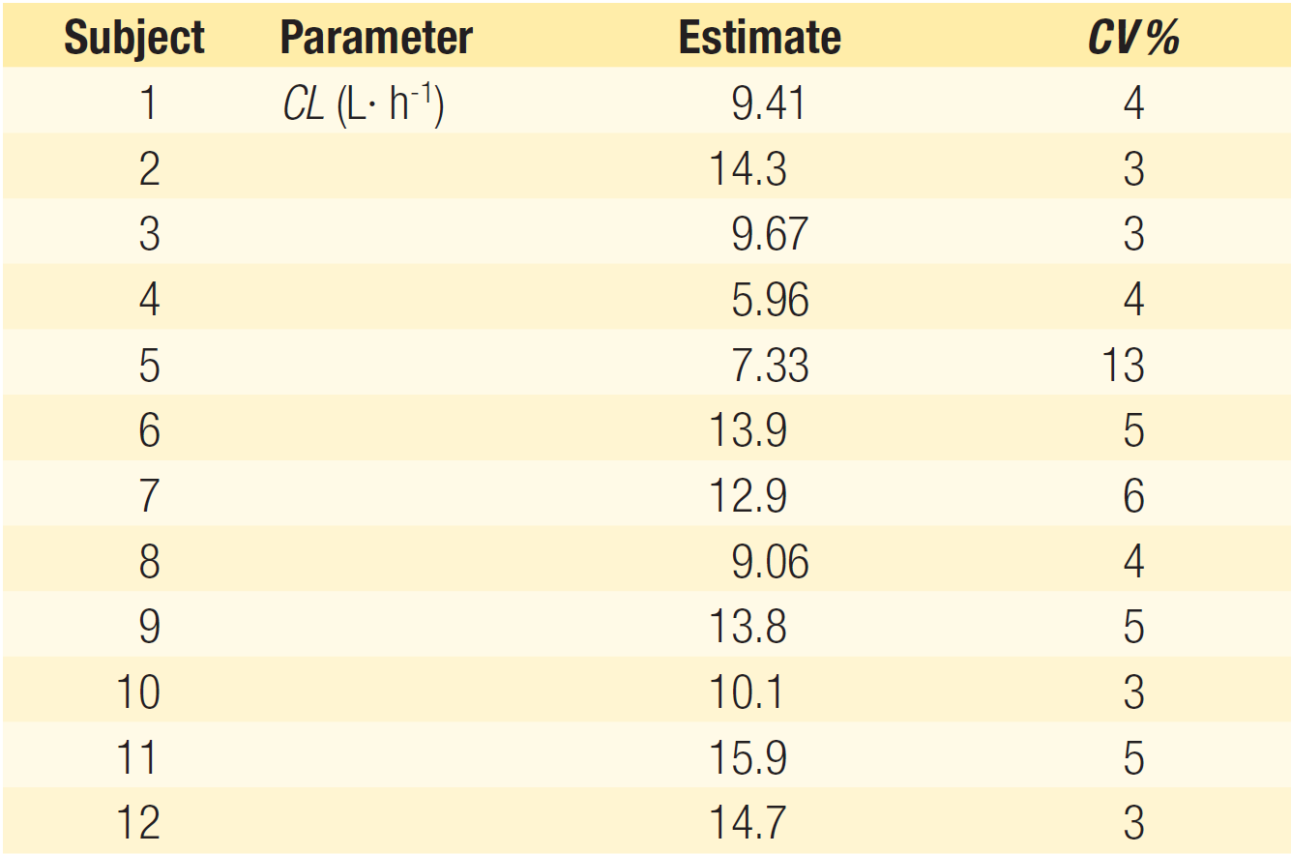
PK50 Analysis of multiple subjects
CL
9.897063
14.265702
9.645258
6.326855
8.706887
15.025262
13.254392
9.340621
14.873488
10.561968
17.102183
14.915294

Slide 11
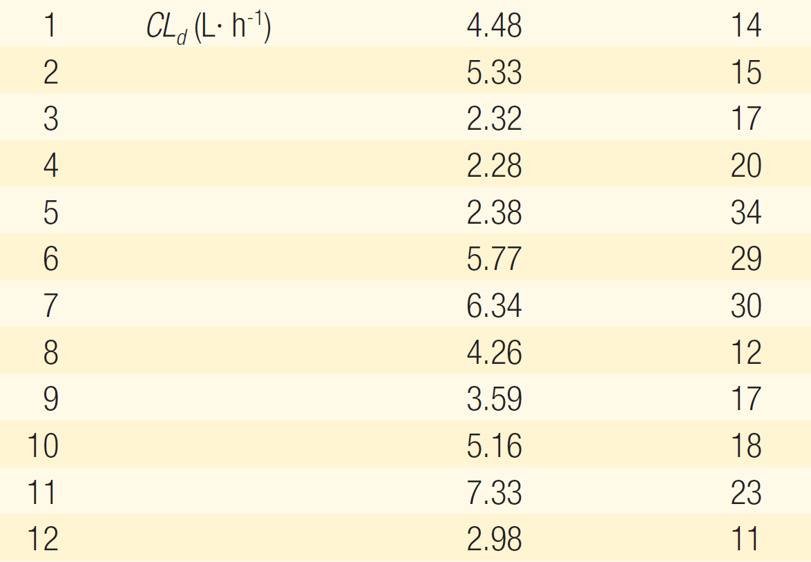
PK50 Analysis of multiple subjects
CLd
4.633642
5.007235
2.119850
3.819067
2.647359
13.347022
5.949381
4.125270
4.347647
6.674391
8.266373
3.433052

Slide 12
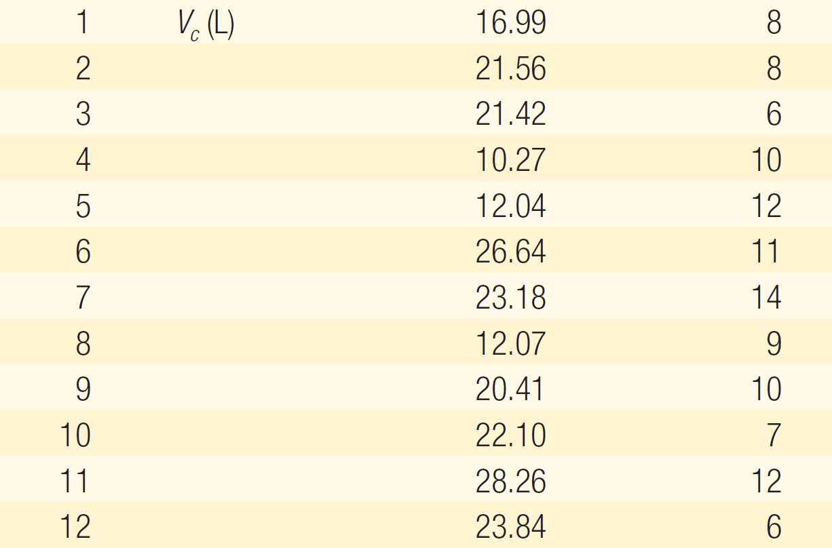
PK50 Analysis of multiple subjects
Vc
18.187989
20.311831
21.232169
9.425423
11.187009
21.088087
21.277327
12.907665
21.080374
22.398295
29.880453
21.953160

Slide 13
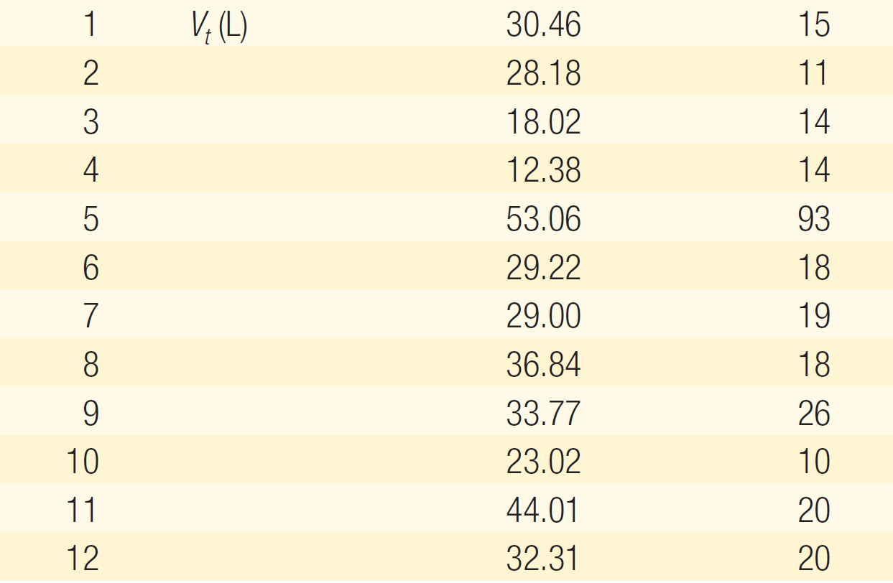
PK50 Analysis of multiple subjects
Vt
26.19736
25.22711
17.34608
11.25341
20.10544
29.87090
24.27270
34.74399
25.79087
20.36938
37.38242
23.93740

Slide 14
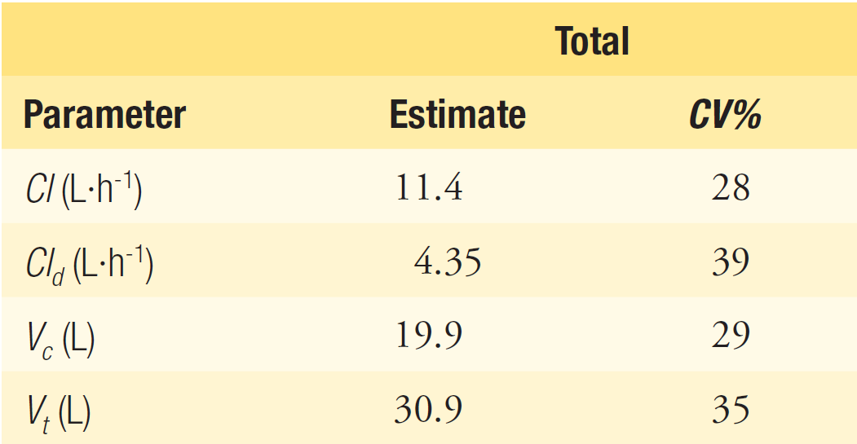
PK50 Analysis of multiple subjects
$Est
CL CLd Vc Vt
PE 11.7849228 3.6851956 19.446899 15.75607
SE 0.3424158 0.9050915 1.405665 2.66455
RSE 2.9055417 24.5602016 7.228223 16.91126

Slide 15
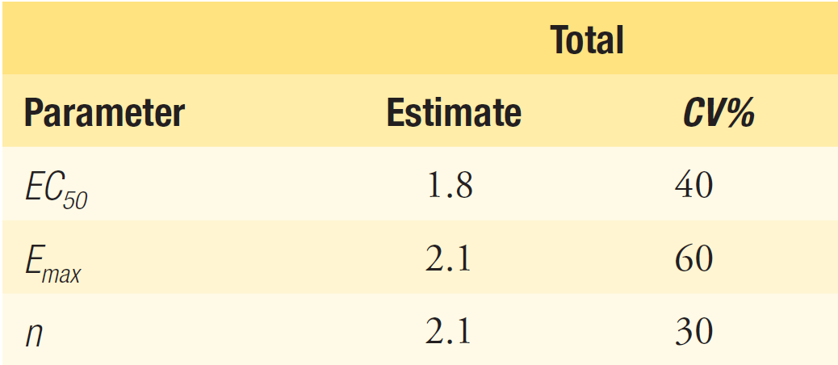
PK50 Analysis of multiple subjects
$Est
EC50 Emax n
PE 1.261788 1.74565583 3.0030001
SE 0.163241 0.08691539 0.7952273
RSE 12.937278 4.97895351 26.4810957

Slide 16
PK51 Multi-compartment drug/metabolite
#ID | TIME | AMT | RATE | CMT | DV | MDV
1 | 0 | 5000 | 1000 | 2 | . | 1
1 | 2 | . | . | 2 | 100 | 0
1 | 5 | . | . | 2 | 240 | 0
1 | 5 | . | . | 4 | 61 | 0
1 | 10 | . | . | 2 | 199 | 0
1 | 10 | . | . | 4 | 130 | 0
1 | 15 | . | . | 2 | 175 | 0
1 | 15 | . | . | 4 | 156 | 0
1 | 30 | . | . | 2 | 110 | 0
1 | 30 | . | . | 4 | 140 | 0
1 | 45 | . | . | 2 | 68 | 0
1 | 45 | . | . | 4 | 110 | 0
1 | 60 | . | . | 2 | 43 | 0
1 | 60 | . | . | 4 | 92 | 0
1 | 90 | . | . | 2 | 19 | 0
1 | 90 | . | . | 4 | 71 | 0
1 | 120 | . | . | 2 | 10 | 0
1 | 120 | . | . | 4 | 61 | 0
1 | 180 | . | . | 2 | 3.7 | 0
1 | 180 | . | . | 4 | 55 | 0
1 | 240 | . | . | 2 | 2.1 | 0
1 | 240 | . | . | 4 | 50 | 0
1 | 480 | . | . | 2 | 0.54 | 0
1 | 480 | . | . | 4 | 40 | 0
#ID | TIME | AMT | RATE | CMT | DV | MDV
2 | 0 | 8000 | . | 1 | . | 1
2 | 21 | . | . | 2 | 1 | 0
2 | 21 | . | . | 4 | 1 | 0
2 | 30 | . | . | 2 | 25 | 0
2 | 30 | . | . | 4 | 205 | 0
2 | 45 | . | . | 2 | 33 | 0
2 | 45 | . | . | 4 | 210 | 0
2 | 60 | . | . | 2 | 33 | 0
2 | 60 | . | . | 4 | 180 | 0
2 | 120 | . | . | 2 | 13 | 0
2 | 120 | . | . | 4 | 115 | 0
2 | 240 | . | . | 2 | 1.77 | 0
2 | 240 | . | . | 4 | 85 | 0
2 | 360 | . | . | 2 | 0.6 | 0
2 | 360 | . | . | 4 | 73 | 0
2 | 480 | . | . | 2 | 0.25 | 0
2 | 480 | . | . | 4 | 65 | 0
2 | 720 | . | . | 2 | 0.07 | 0
2 | 720 | . | . | 4 | 50 | 0
2 | 1440 | . | . | 4 | 21 | 0

Slide 17
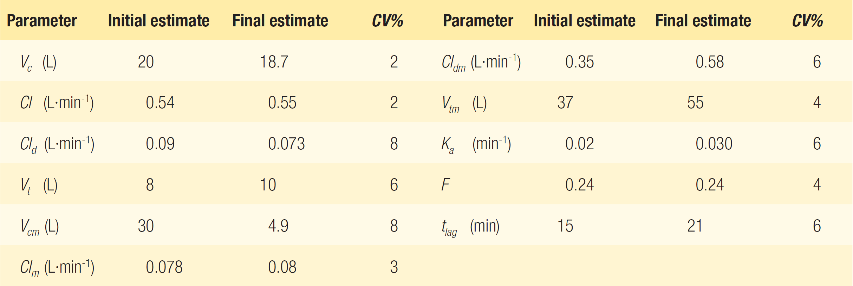
PK51 Multi-compartment drug/metabolite
WNL 6.4
19.4177
0.564672
0.069842
10.287
4.93508
0.080676
WNL6.4
0.550319
57.3215
0.031929
0.244834
20.718

Slide 18
Others to note
Marginally different point estimate
PK6, PK9, PK17, PK20, PK25, …
Different CV (standard error)
PK12, PK18(Km), PK20(PB correction), PK26, PK27, PK45(Model 1), …
Unstable fitting (initial value sensitivity)
PK14(no lag additive error), PK23(dispersion), PK33, PK51, PK53, …
Insufficient information (unsolvable)
PK35 (분산-공분산에 대한 정보가 부족함)

Slide 19
Conclusion
Do not use any software blindly!
Nonlinear regression is still difficult task.
NONMEM® is the most reliable one.
R is the slowest, but will improve.
Use ‘maximum likelihood estimation’ type methods instead of ‘least square fitting.’
NONMEM®, Phoenix NLME: Maximum Likelihood Estimation
WinNonlin® 5.x or earlier: Least Square Fitting
Standard error or CV from ‘least square fitting’ is quite unreliable.

